Slide 1
10 ways to improve website performance based on behavioural science
Mike Weir
@MikeWeir

Slide 2
Mike Weir
Professional background
Working in digital design for just over 10 years.
Head of Behavioural Science for Impression Digital
Currently undertaking a PhD at MMU understanding how commerce interfaces are motivation at brain level.
BRANDS I HAVE WORKED WITH:

Slide 3
This year $674 Billion pounds will be
spent worldwide on advertising.
That’s $75 for every man, woman
and child on earth.
On average 1.8% of customers convert.
@MikeWeir
#brightonseo
Notes:
Source: https://www.insiderintelligence.com/content/uk-ad-spending-2023
Insider intelligence ad spending report 2023 UK

Slide 4
=
Marketing
Psychology
Notes:
Source: https://www.insiderintelligence.com/content/uk-ad-spending-2023
Insider intelligence ad spending report 2023 UK

Slide 5
What is Behavioural Science?
@MikeWeir
#brightonseo

Slide 6
The systematic study of human
behaviour using observation
and experimentation.
@MikeWeir
#brightonseo
Notes:
Source: https://www.insiderintelligence.com/content/uk-ad-spending-2023
Insider intelligence ad spending report 2023 UK

Slide 7
M.I.N.D.S.P.A.C.E
.Salience.
Our attention is drawn to novel things that seem relevant to us.
.Defaults.
We “go with the flow” of pre-set options
.Priming.
Our actions are often influenced by subconscious cues.
S
D
P
.Norms.
We are heavily influenced by what others do.
.Affect.
Our actions can be powerfully shaped by our emotional associations.
N
A
.Incentives.
Our responses to incentives are shaped by predictable mental shortcuts, such as the strong desire to avoid losses.
.Commitments.
We seek to be consistent with our public promises and to reciprocate actions.
I
C
M
E
.Messenger.
We are heavily influenced by who is communicating information.
.Ego.
We act in ways that make us feel better about ourselves.

Slide 8
Messenger
@MikeWeir
#brightonseo

Slide 9
Liking:
Similar
Complimentary
Co-operative

Slide 11
Incentives
@MikeWeir
#brightonseo

Slide 12
Intrinsic and Extrinsic Motivation:
Intrinsic
Extrinsic

Slide 13
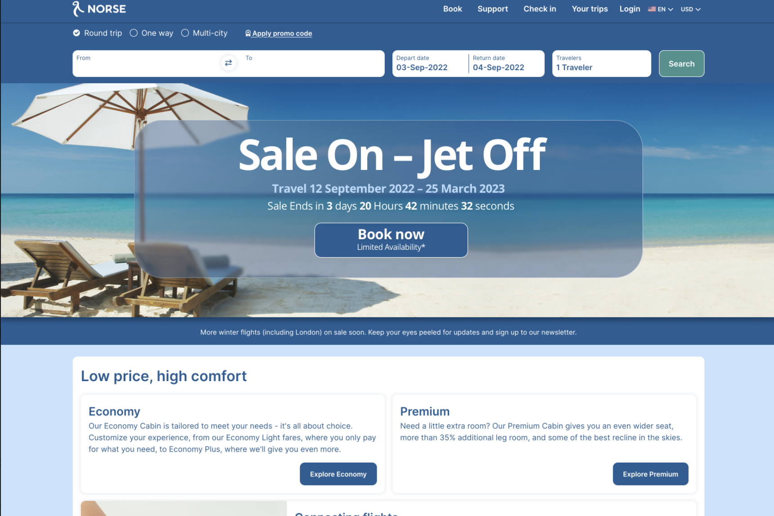

Slide 14
Dopamine Rewards:
BASELINE
CUE
REWARD
Unexpected Reward
(learning)
Expected Reward
Introduction of beneficial
Unexpected Reward

Slide 15
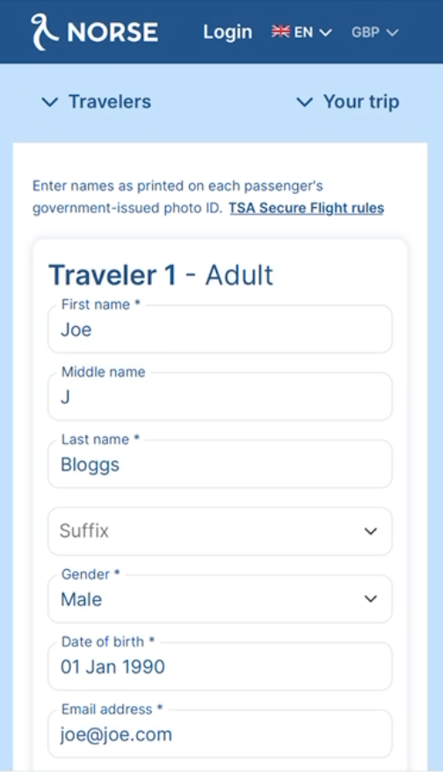
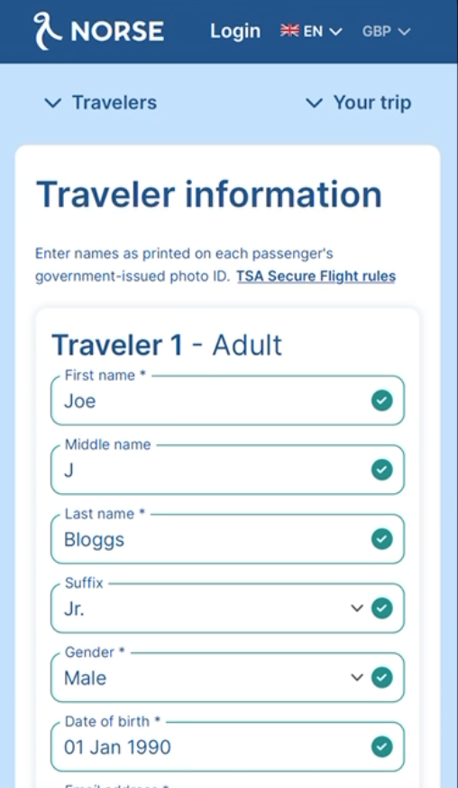
+3.4% Increase in conversion on Mobile
Control
Variation

Slide 16
Norms
@MikeWeir
#brightonseo

Slide 17
Norms

Slide 18
59% increase in mobile conversions by using utilising trust…

Slide 19
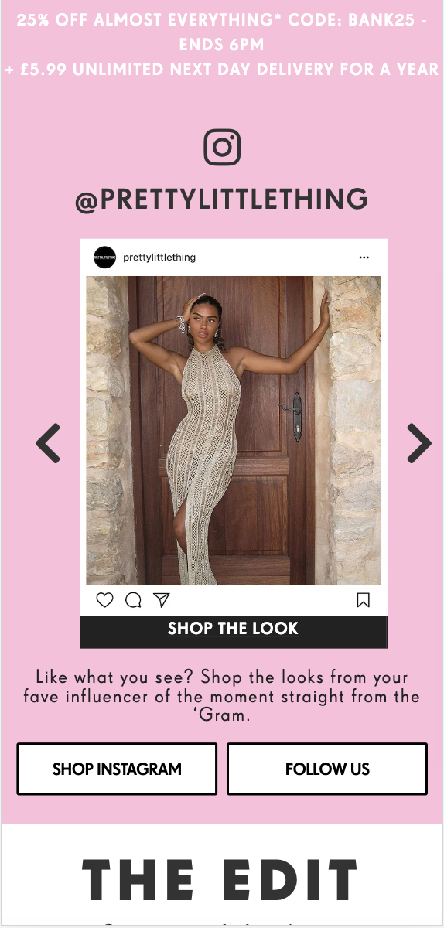
UGC Content:

Slide 20
Defaults
@MikeWeir
#brightonseo

Slide 21
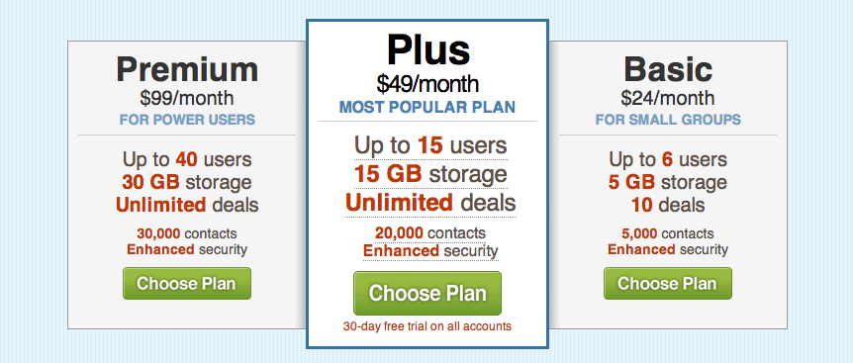
Defaults:

Slide 22
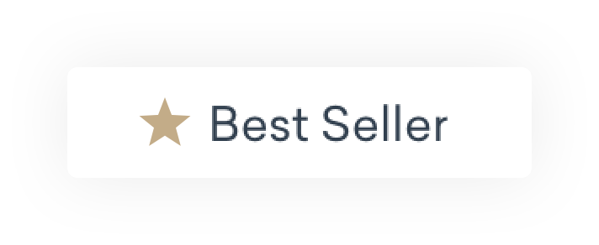
Car Retail Service:
Control

Slide 23
+3% increase in bookings & +27% increase in additional services added
Variation

Slide 24
Salience
@MikeWeir
#brightonseo

Slide 25
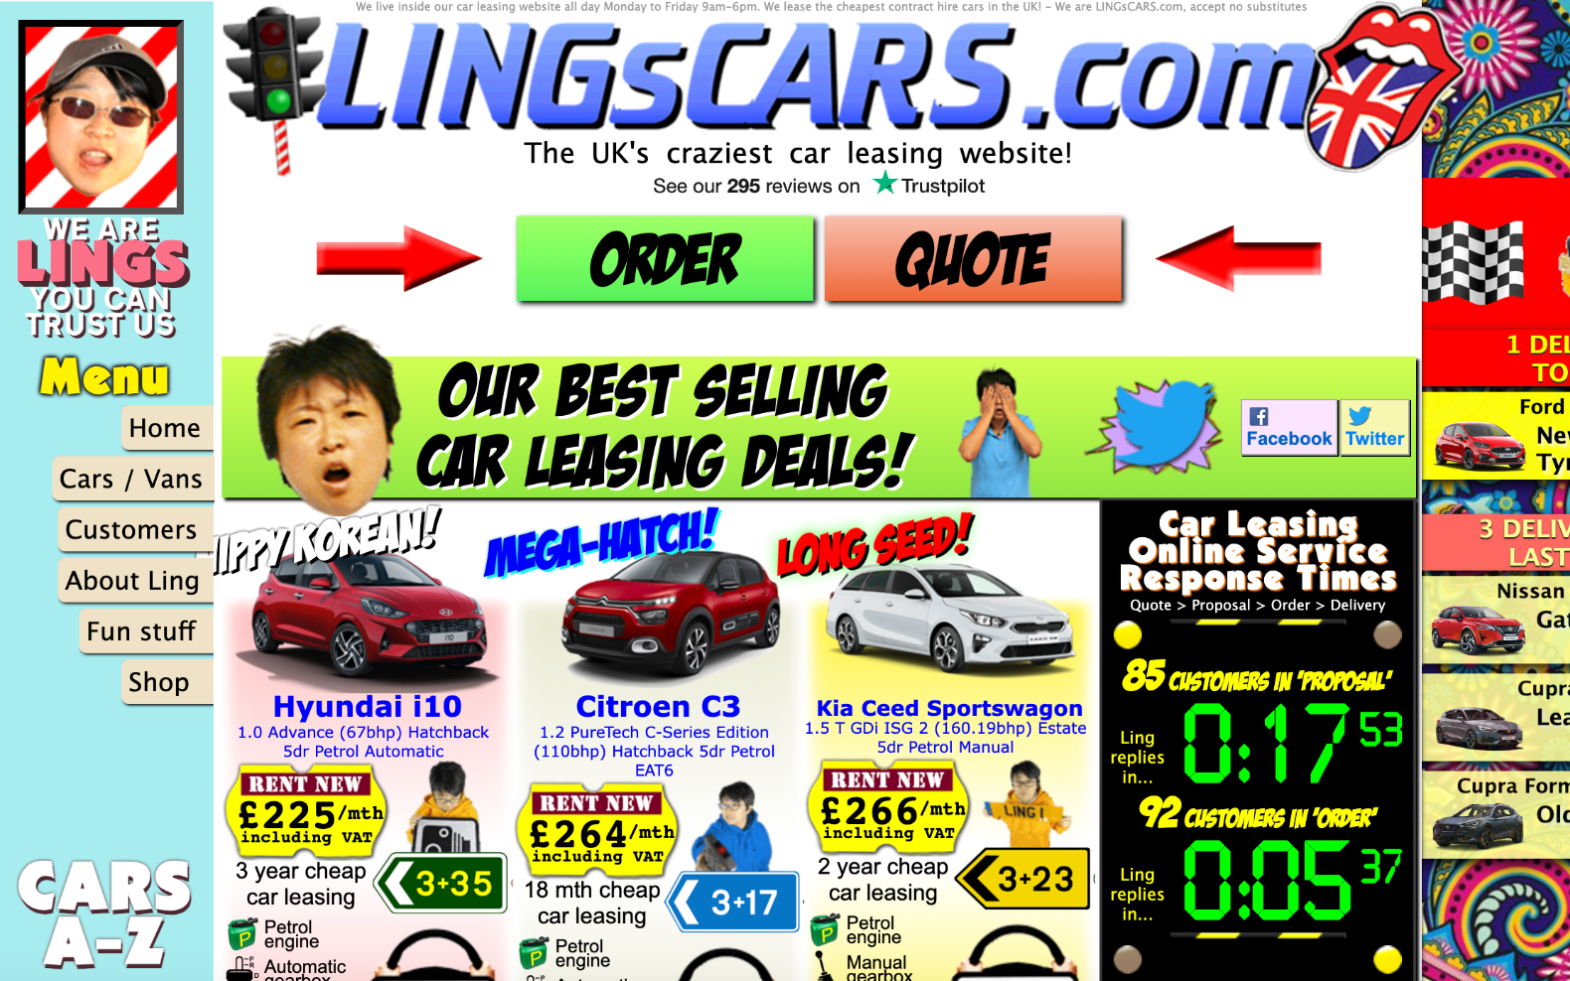

Slide 26
Salience:

Slide 27
Attention:

Slide 28
+22% Increase in bookings on mobile
Control
Variation

Slide 29
Priming
@MikeWeir
#brightonseo

Slide 30
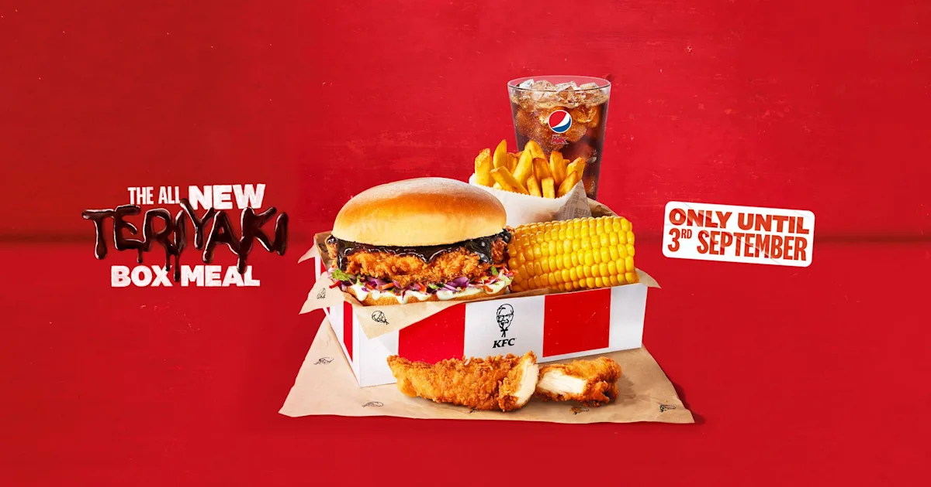
Priming:

Slide 31
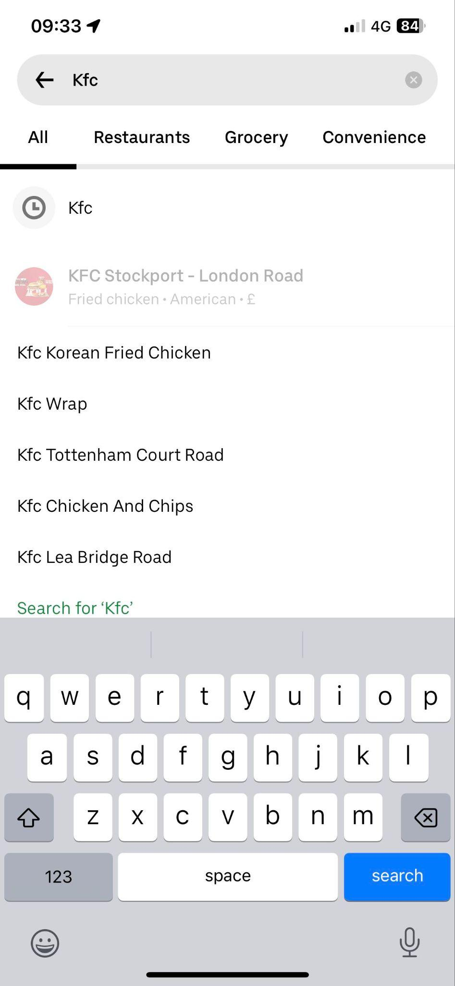
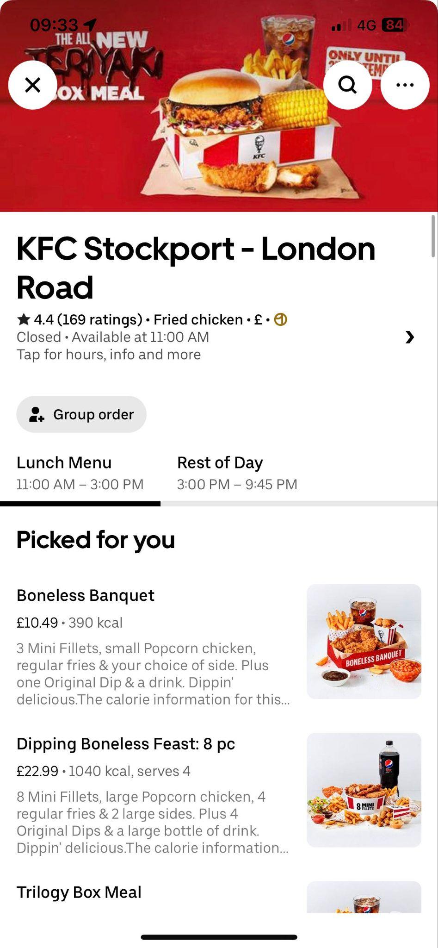
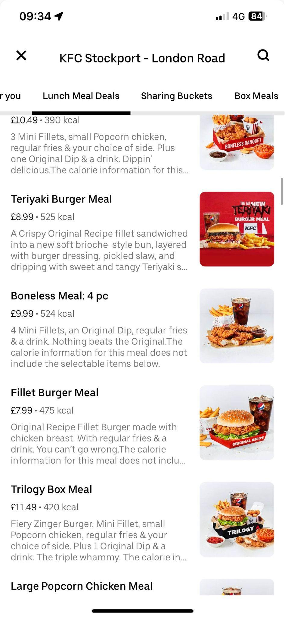
Priming:

Slide 32
Affect
@MikeWeir
#brightonseo

Slide 33
Moods, Emotions, Feelings:

Slide 34
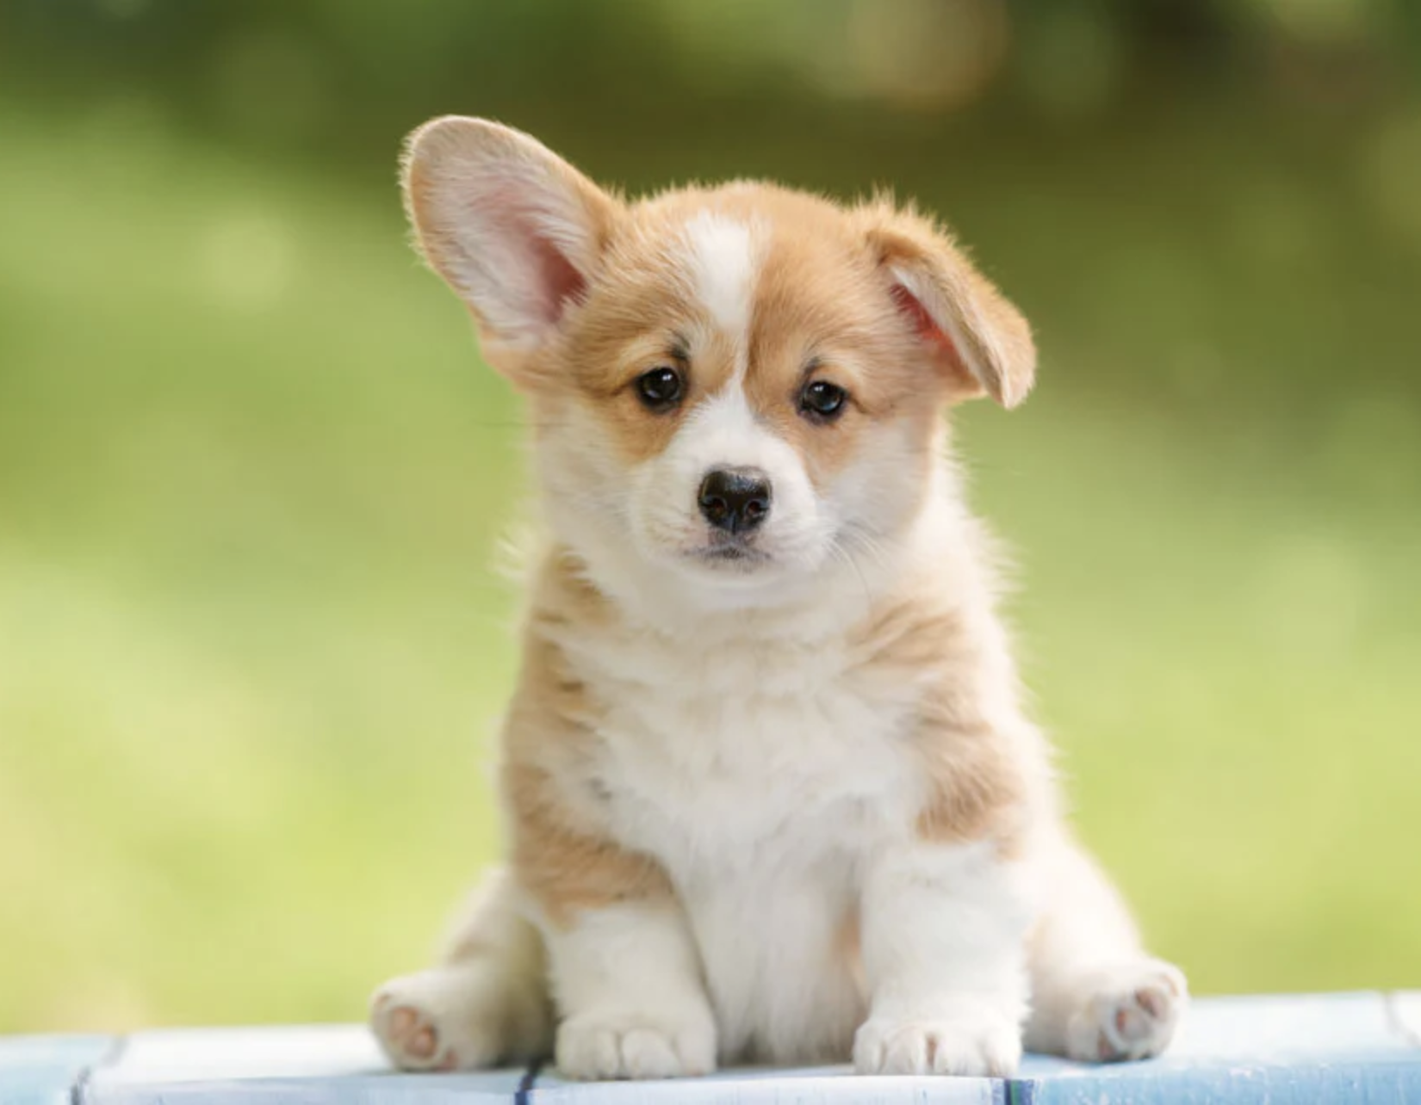

Slide 36
Commitments
@MikeWeir
#brightonseo

Slide 37
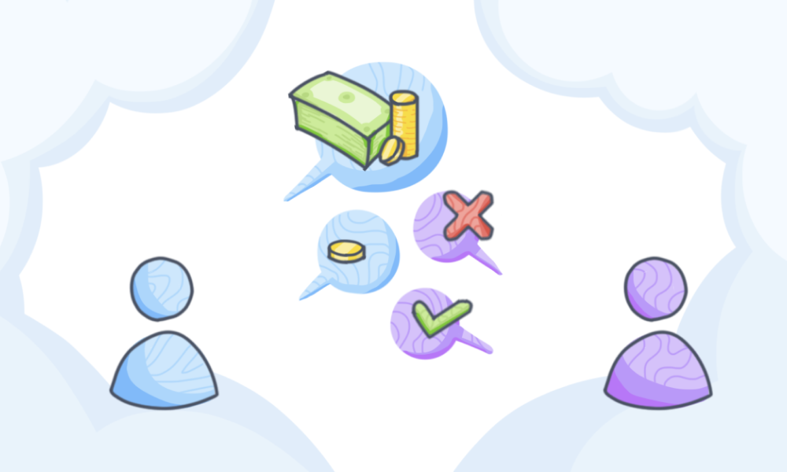
Commitment

Slide 38
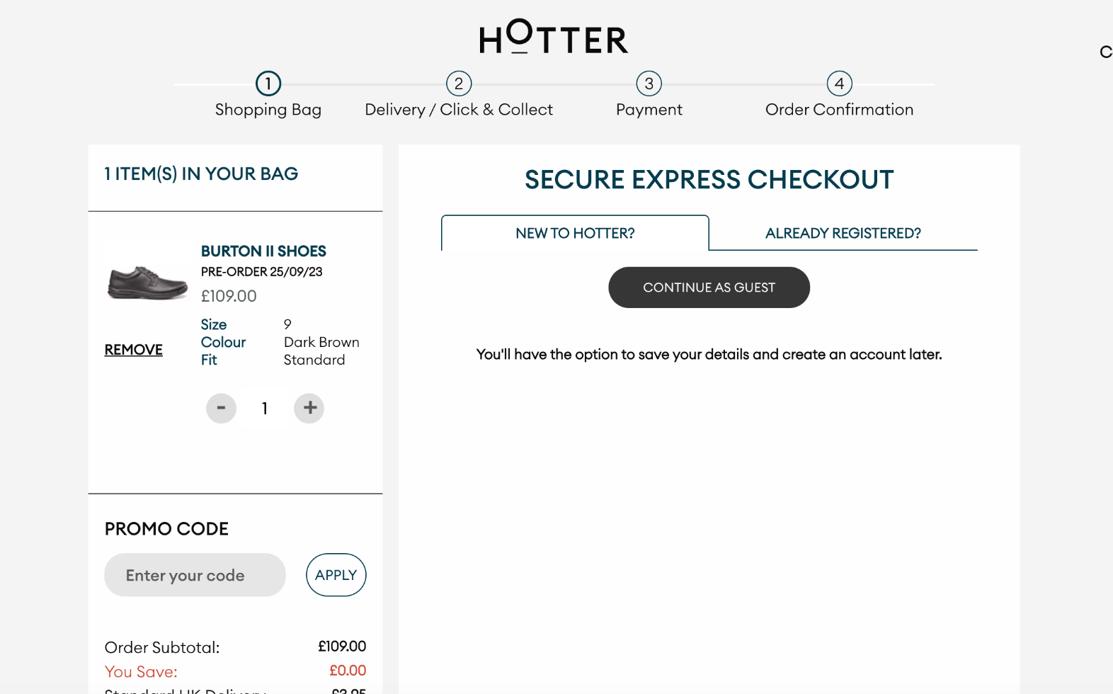
Commitment

Slide 39
Ego
@MikeWeir
#brightonseo

Slide 40
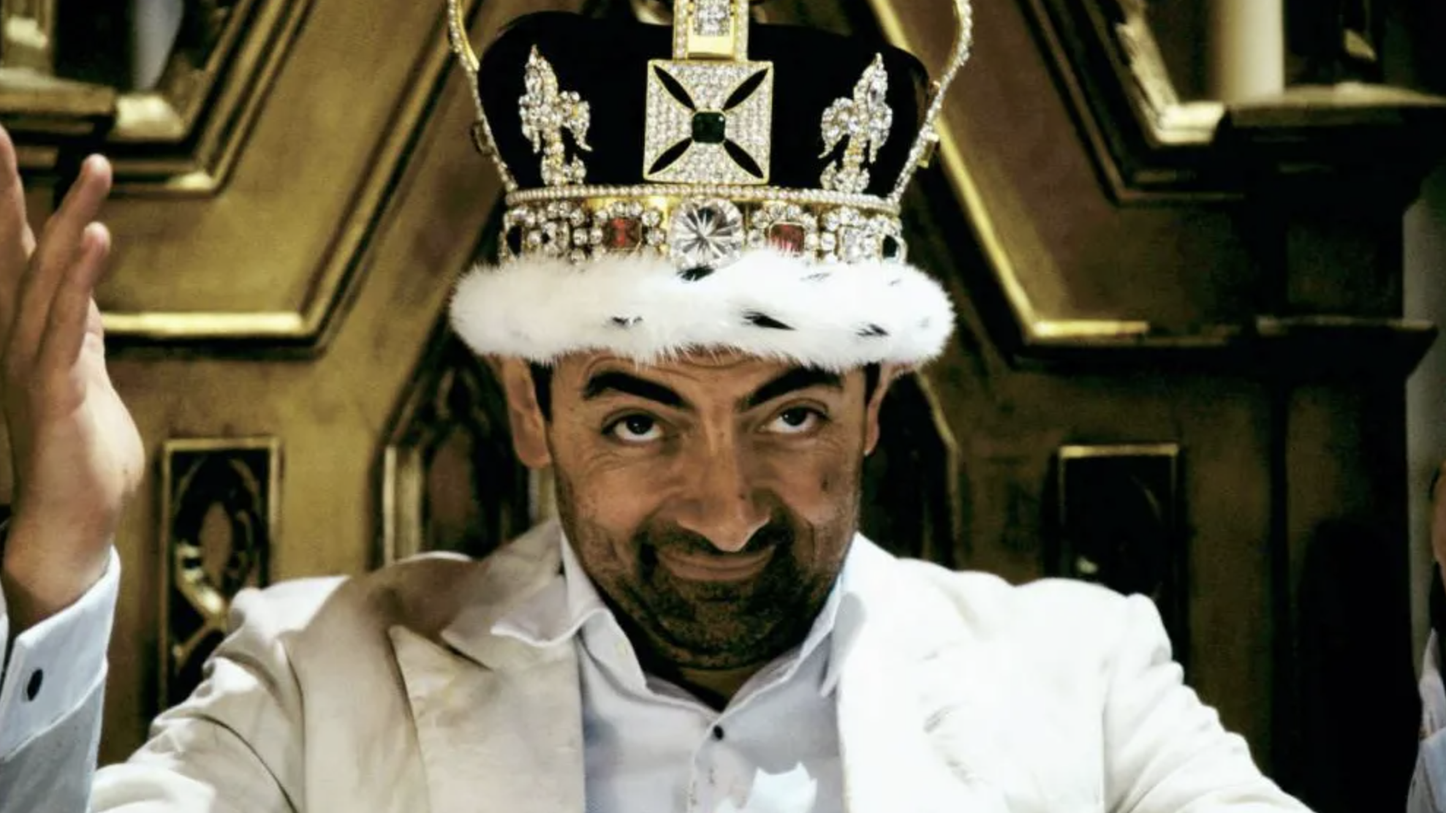

Slide 41
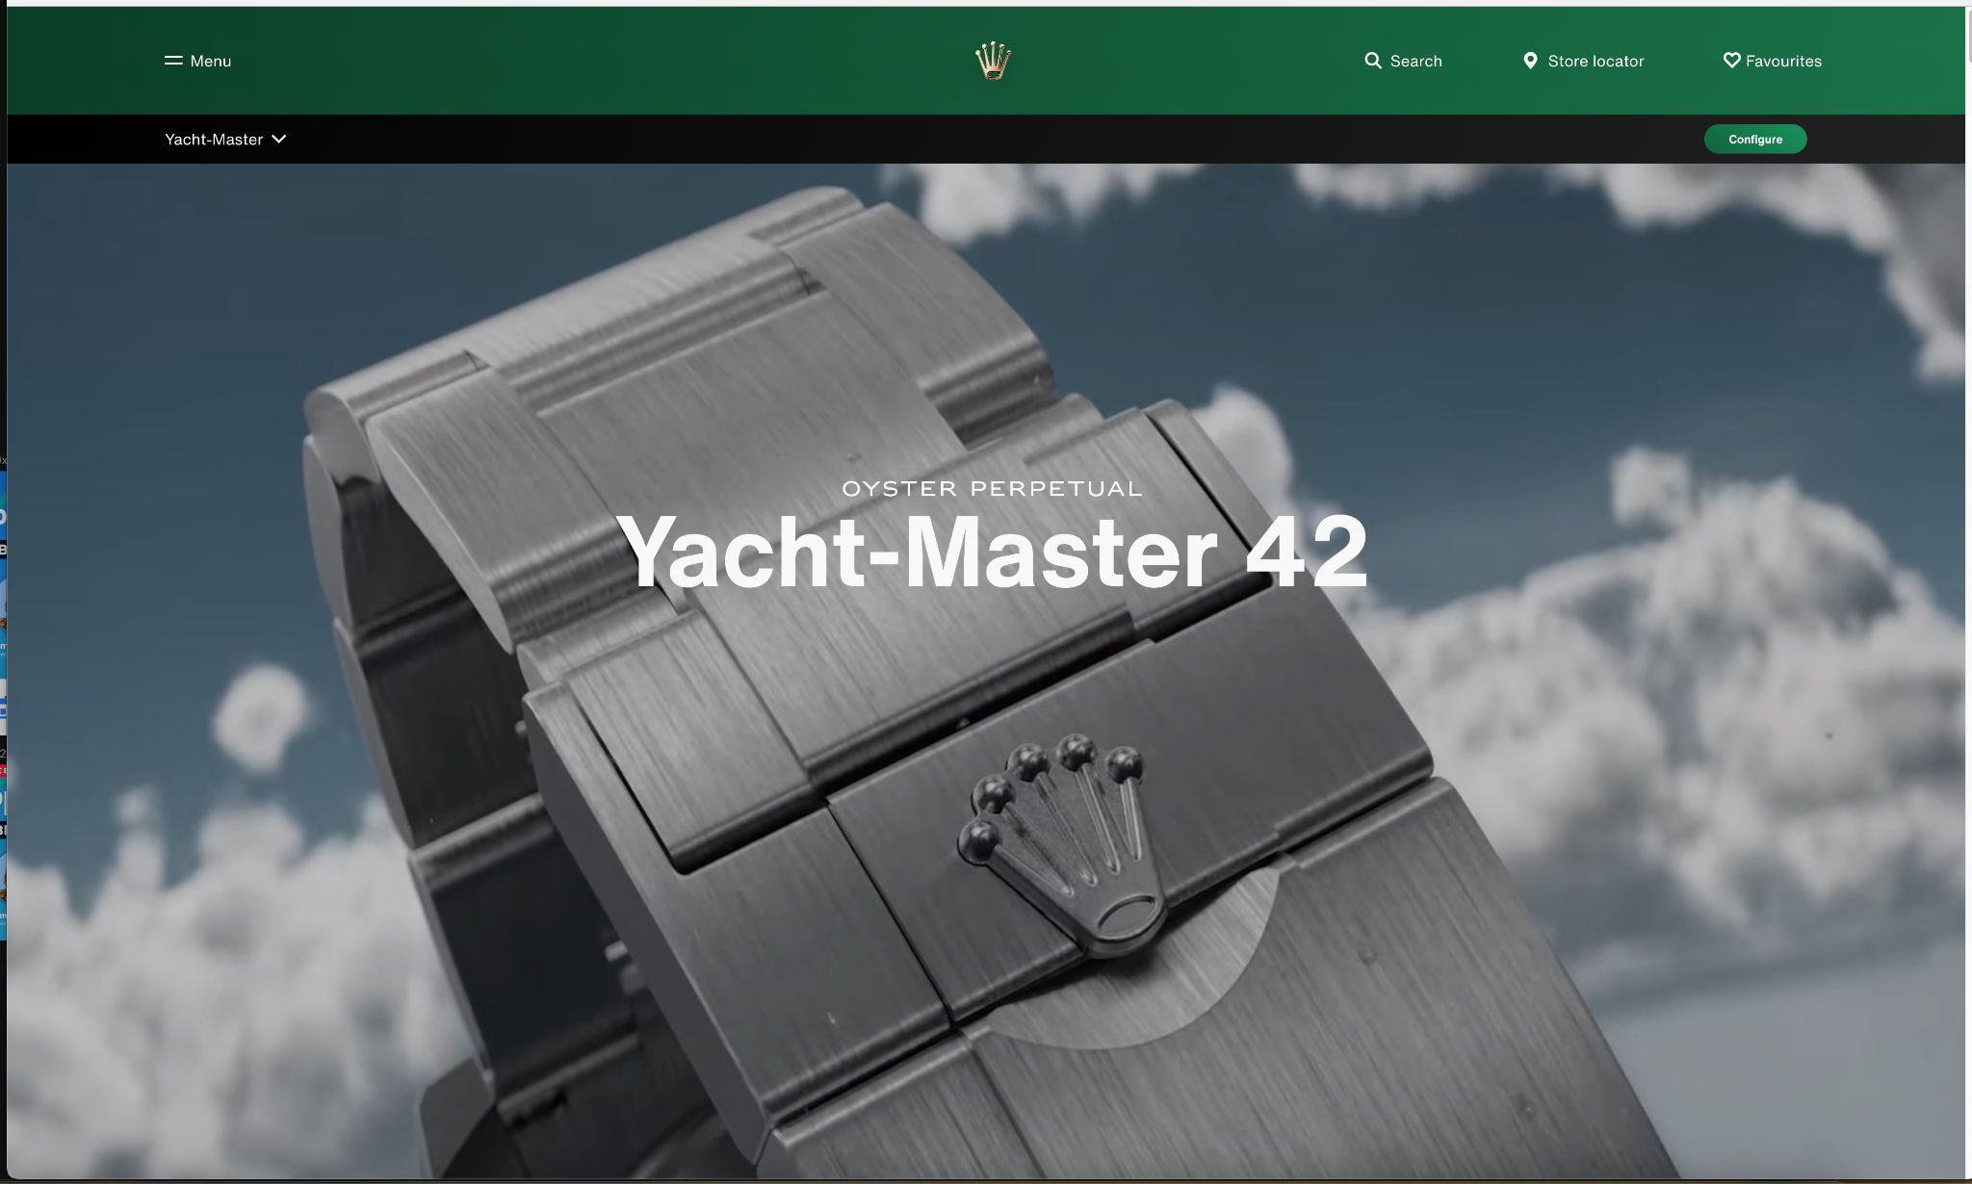
Ego

Slide 42
Don’t take my word for it!
@MikeWeir
#brightonseo

Slide 43
De-risking Digital Experience:
LOW
META EXPERIMENTATION ANALYSIS
CONTROLLED EXPERIMENTATION
Risk to revenue
QUANT ANALYSIS
QUAL RESEARCH
EXPERT & COMPETITOR REVIEWS
HIGH
OPINIONS, MYTHS & ‘BEST PRACTICE’

Slide 44
Experimentation Process
.Discovery & Analysis.
In-depth analysis and user research form the basis for test hypothesis.
.Roadmap Prioritisation.
The backbone to testing operations, updated in-line with analysis & learnings.
.Deployment to Production.
Successful test variants briefed into internal developments teams.
.Optimisation. .Cycle.
How we approach a CRO project.
.Reporting & Test Summary.
Tests run until 90% statistically significant against primary KPIs
.Test Proposal
Initial experimentation documentation for experiment and user experience description.
.Run Experiments.
After final configuration tests are launched and data begins to collect.
.UX/UI Design.
High-fidelity designs of chosen variants provided via Figma for review.
.Development & Q.A..
Pixel perfect variant development with a vigorous quality assurance process

Slide 45
Experimentation Process
CONVERSION RATE

Slide 46
Experimentation benefits
Budget Efficiency
Generate more for less spend. Offset rising media platform costs.
Multi Channel Impact
Realise a multi channel benefit which amplifies impact from the investment.
Validate Ideas
Use testing to prove or disprove hypotheses and settle debates.
Customer Insight
Understand your audiences to deliver a better user experience.
Revenue & Sales Uplift
Improve conversion rate to increase revenue and grow faster.
Operational Efficiency
Creating trust can reduce customer comms and labour intensive operations.
Improve Usability
Identify and fix usability issues on your website to improve experiences.
Brand Perception
Improve end-to-end CX to build loyalty, reviews and customer referrals.
A
▲ 22% Uplift
B

Slide 47
Key Takeaways
@MikeWeir
#brightonseo

Slide 48
Key Takeaways
Behavioural Science will boost your conversion rates.
Use research to better understand your audience.
Conduct experiments to help prove or disprove opinions.
Psychology can influence your audiences perceptions.
Spend time refining your value proposition.

Slide 49
Behavioural Science
Page Review
OFFER
@MikeWeir
#brightonseo

Slide 50
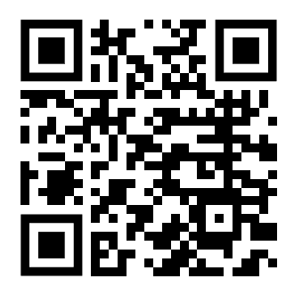
linkedin.com/in/mjwcro/

